Slide 1



http://pingo.edu.vn/khoa-hoc-php-can-ban/
PHP Basics – Files – Date Time
Web Applications in Hatch
Tuan Duong
http://pingo.edu.vn/tuan-duong/

Slide 2
Contents – Files
Introduction
Creating a File
Opening a File
Reading From a File
Writing to File
Removing File
Appending Data
File Locking

Slide 3
Contents - Files
Uploading Files via an HTML Form
More File Functions
Directory Functions
Getting a Directory Listing

Slide 4
Contents – Datetime
Introduction
Timezones
date($format, $when)
strtotime($when)

Slide 5
Introduction
Manipulating files is a basic necessity for serious programmers and PHP gives you a great deal of tools for creating, uploading, and editing files.
This is one of the most fundamental subjects of server side programming in general. Files are used in web applications of all sizes.

Slide 6
Creating a File
In PHP the fopen function is used to open files. However, it can also create a file if it does not find the file specified in the function call. So if you use fopen on a file that does not exist, it will create it, given that you open the file for writing or appending.
$ourFileName = "testFile.txt"; $ourFileHandle = fopen($ourFileName, 'w') or die("can't open file"); fclose($ourFileHandle);

Slide 7
File Operations Mode

Slide 8
Opening a File
The fopen() function is used to open files in PHP.
<?php $file = fopen("welcome.txt", "r") or exit("Unable to open file!"); fclose($file);

Slide 9
Reading From a File
The fgets() function is used to read a single line from a file.
<?php $file = fopen("welcome.txt", "r") or exit("Unable to open file!"); //Output a line of the file until the end is reached while (!feof($file)) { echo fgets($file). "<br>"; } fclose($file);
Notes:
fgets(file,length): file: Required. Specifies the file to read from
Length: Optional. Specifies the number of bytes to read. Default is 1024 bytes.

Slide 10
Writing to a File
We can use php to write to a text file. The fwrite function allows data to be written to any type of file.
$myFile = "testFile.txt"; $fh = fopen($myFile, 'w') or die("can't open file"); $stringData = "Kabul is the capital\n"; fwrite($fh, $stringData); $stringData = "Samangan is a province\n"; fwrite($fh, $stringData); fclose($fh);

Slide 11
Removing File
In PHP you delete files by calling the unlink function.
$myFile = "testFile.txt"; unlink($myFile);

Slide 12
Appending Data
$myFile = "testFile.txt"; $fh = fopen($myFile, 'a') or die("can't open file"); $stringData = "New Stuff 1\n"; fwrite($fh, $stringData); $stringData = "New Stuff 2\n"; fwrite($fh, $stringData); fclose($fh);
Notes:
The above example may not seem very useful, but appending data onto a file is actually used everyday. Almost all web servers have a log of some sort.

Slide 13
File Locking
The key problem with file system operations is the situation you are in if two scripts attempt to write to a file at the same time.
The fopen() function, when called on a file, does not stop that same file from being opened by another script.

Slide 14
File Locking
LOCK_SH to acquire a shared lock (reader).
LOCK_EX to acquire an exclusive lock (writer).
LOCK_UN to release a lock (shared or exclusive).

Slide 15
File Locking
$fp = fopen( $filename,"w"); // open it for WRITING ("w") if (flock($fp, LOCK_EX)) { // do your file writes here flock($fp, LOCK_UN); // unlock the file } else { // flock() returned false, no lock obtained print "Could not lock $filename!\n"; }

Slide 16
Uploading Files via an HTML Form
With PHP, it is possible to upload files to the server.
<!DOCTYPE html> <html> <body> <form action="upload.php" method="post" enctype="multipart/form-data"> <label for="file">Filename:</label> <input type="file" name="file" id="file"><br> <input type="submit" name="submit" value="Submit"> </form> </body> </html>

Slide 17
Uploading Files via an HTML Form
<?php if ($_FILES["file"]["error"] > 0) { echo "Error: " . $_FILES["file"]["error"] . "<br>"; } else { echo "Upload: " . $_FILES["file"]["name"] . "<br>"; echo "Type: " . $_FILES["file"]["type"] . "<br>"; echo "Size: " . ($_FILES["file"]["size"] / 1024) . " kB<br>"; echo "Stored in: " . $_FILES["file"]["tmp_name"]; } ?>

Slide 18
Uploading Files via an HTML Form
; Maximum allowed size for uploaded files. upload_max_filesize = 40M ; Must be greater than or equal to upload_max_filesize post_max_size = 40M

Slide 19
Directory Functions
scandir()
getcwd()
<?php var_dump(scandir(”projects")); ?>
<?php echo getcwd(); ?>

Slide 20
Directory Functions
chdir()
The chdir() function changes the current directory to the specified directory.
<?php //Get current directory echo getcwd(); echo "<br />"; //Change to the images directory chdir(”projects"); echo "<br />"; echo getcwd();

Slide 21
More File Functions
http://php.net/manual/en/ref.filesystem.php

Slide 22
DEMO

Slide 23
Datetime
Timezones
Most places have whole-hour timezone offset
Some places change timezones during the year
One identifier can mean different zones: PST (Pacific Standard, Pakistan Standard Time), EST (Eastern Standard Time – USA, Eastern Standard Time – Australia, Eastern Brazil Standard Time)
Bundled timezone database with 564 zones
Not dependent on timezone abbreviation
Timezones have the format: Continent/Location or Continent/Location/Sublocation. Ex: Europe/Amsterdam, America/Indiana/Knox

Slide 24
Datetime
Timezones
An updated database is released about 20 times a year
Some of changes are very sudden.
PHP releases will therefore often have an outdated version
Can be updated frequently using PECL (PHP Extension Community Library) extension.

Slide 25
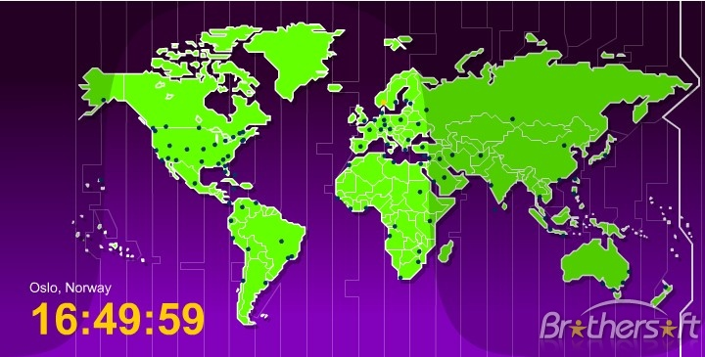
Timezones

Slide 26
Datetime
Timestamp
Unix time (as know as POSIX time or Epoch time)
Defined as the number of seconds since midnight, January 1 1970.
Using time() function to get current timestamp that is timezone independent.

Slide 27
date() - format
d – day of the month with leading zero
l – day of the week (Sunday, Monday)
F – month (January, July)
m – month with leading zero
Y – four-digit year
h – twelve hour format with leading zero
i – minutes with leading zero
s – seconds with leading zero
a – am/pm

Slide 28
date() – when
$when: Unix timestamp
Example:
<?php
echo "Current default date and time: " . date("Y-m-d H:i:s", time());
date_default_timezone_set("Asia/Ho_Chi_Minh");
echo "<br />";
echo "Date and time in Ho Chi Minh: " . date("Y-m-d H:i:s", time());
?>

Slide 29
strtotime($when, optional $now)
$when: Parse about any English textual datetime description into a Unix timestamp
$now: (optional) The timestamp which is used as a base for the calculation of relative dates.
Example:
<?php
echo strtotime("now") . "<br />";
echo strtotime("10 September 2000") . "<br />";
echo strtotime("+1 day") . "<br />";
echo strtotime("+1 week") . "<br />";
echo strtotime("+1 week 2 days 4 hours 2 seconds") . "<br />";
echo strtotime("Next Thursday") . "<br />";
echo strtotime("Last Sunday") . "<br />";
?>

Slide 30
PRACTICE

Slide 31
PHP Basics - Strings

